Slide 1


Wavecon Telecom Analysis
"Wavecon : Riding the Wave of 5G Technology - Empowering Tomorrow's Telecom Landscape"
PRESENTED BY :
HARSHIT ARORA

Slide 2

ABOUT US
Wavecon is a leading telecommunications company renowned for its innovative solutions and commitment to delivering seamless connectivity experiences. With a focus on cutting-edge technology and customer satisfaction, Wavecon continually shapes the future of communication.

Slide 3


OBJECTIVE
To effectively communicate the insights extracted from the dashboard and provide a comprehensive understanding to our telecom client, Wavecon, regarding the challenges they face in the ever-evolving telecommunications industry.

Slide 4


Agenda
• Impact of the 5G launch on revenue
• Underperforming KPI after the 5G launch
• Performance of different plans after 5G launch and future of these plans

Slide 5


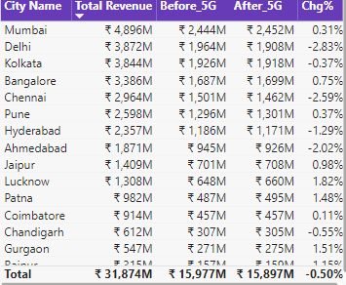
Insights
What is the impact of the 5G launch on our revenue?
The revenue decreased by 80 Bn, reflecting a 0.50% reduction in revenue after the 5G launch.
CITY-WISE REVENUE DISTRIBUTION:-The introduction of 5G had a mixed impact on Wavecon's revenue across different cities. Some cities experienced revenue growth, while others saw a decline.

Slide 6

Key Performance Indicators (KPI)
1. Above 4 are the Key Performance Indicators in this Project. (Revenue, ARPU, TAU, TUSU)
2. ARPU - Average Revenue per user, TAU - Total Active Users, TUSU - Total Unsubscribed Users.
3. The company achieved total of:
Revenue: 31.9bn
ARPU - 200.7
TAU - 161.7M
TUSU - 12.6M

Slide 7

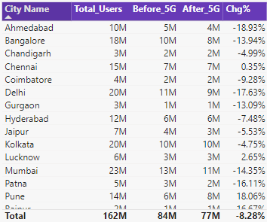
Which KPI is underperforming after the 5G launch?
Total Active Users
We can see that there is -8.28% decrease in the overall active users after the 5G launch.
Ahmedabad, Delhi and Ralpur are the top 3 cities where there is a much decrease in the active users after the 5G launch.

Slide 8

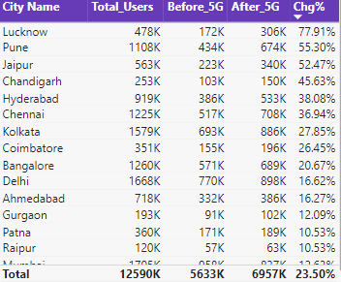
Total Unsubscribed Users
• We can see that there is 23.50% increase in the total unsubscribed users after the 5G launch.
• Lucknow, Pune and Jaipur are the top 3 cities where there is a much increase in the unsubscribed users after the 5G launch.

Slide 9
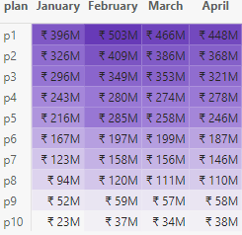
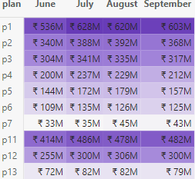
After the 5G launch, which plans are performing well in terms of revenue? Which plans are not performing well?
In June, Wavecon introduced its 5G service.
Plans p1, p2, and p3 maintained consistency and performed effectively following the launch of 5G.
The revenue for plans p4, p5, and p6 has declined.
Plan - p7 experienced a major decrease in revenue, dropping from 146 million to 43 million.
The company discontinued plans p8, p9, and p10 with the introduction of new plans p11, p12 and p13.
Before 5G
After 5G

Slide 10
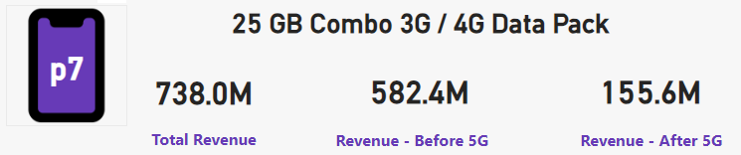
Is there any plan affected largely by the 5G launch? Should we continue or discontinue that plan?
The revenue for Plan - p7 has dropped significantly, from 582 million to 155 million. As a result, the company can discontinue this plan.
There has been a slight decline revenue for plans p4, p5, and p and we can make a few modifications to improve them
Before 5G
After 5G

Slide 11
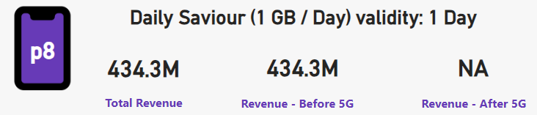
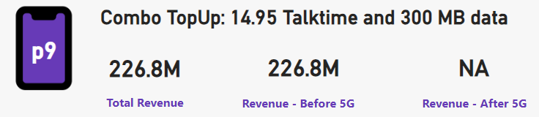
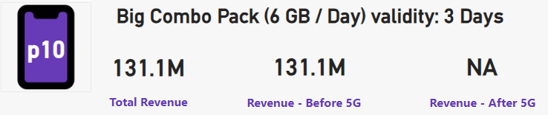
Is there any plan that is discontinued after the 5G launch? What is the reason for it?
Plans for p8, p9, and p10 have been discontinued following the launch of 5G.
Plans p8, p9, and p10 generated significantly less revenue than lie other plans.

Slide 12


Conclusion
Here are some possible explanations for the increase in unsubscribed users after 5G:
The cost of 5G plans may be higher than 4G plans.
Some users may not be satisfied with the performance of the 5G network.
Some users may not need the faster speeds of 5G.
Some users may have switched to other telecom providers that offer 5G plans at a lower price.
Here are some recommendations for Wavecon Telecom:
Conduct a survey of users to understand the reasons for the decrease in revenue and the increase in unsubscribed users.
Offer discounts on 5G plans to attract new users and retain existing users.
Improve the performance of the 5G network to address the concerns of users.
Raise awareness about the benefits of 5G to encourage users to switch to 5G plans

Slide 13

Thanking
You!
harshit.arora1515@gmail.com
https://www.linkedin.com/in/harshit-arora15/

